Slide 1


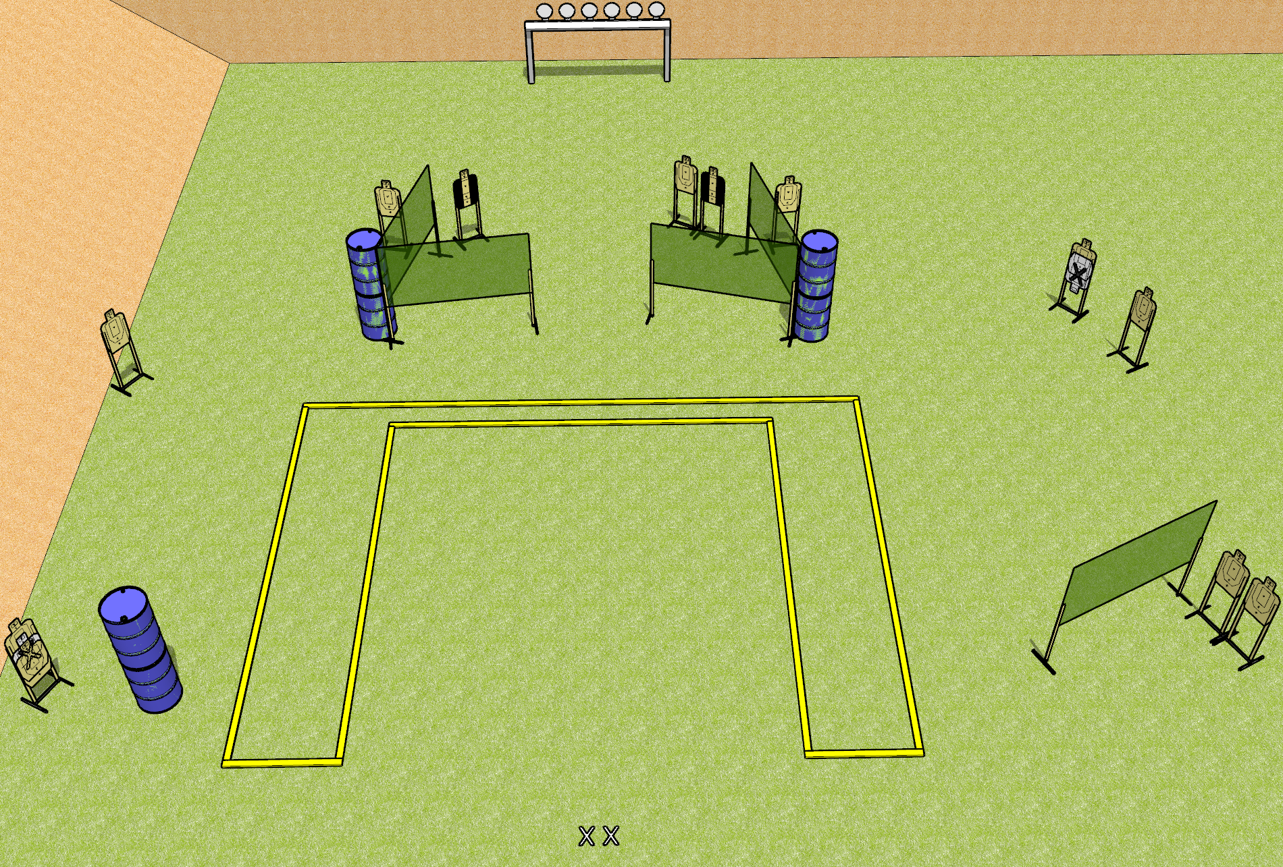
 | Dothan Gun Club – USPSA Match Upside Down Course Designer : Patrick Free
START POSITION : Standing with both feet on X’s, wrists above shoulders, facing uprange
GUN READY CONDITION : Pistol unloaded and holstered. PCC unloaded, stock on belt, facing downrange. |  | SCORING: Comstock, 30 rounds TARGETS: 12 paper, 6 Steel SCORED HITS: Best 2 on paper, steel until down START-STOP: Audible, last shot RULES: Setup note – post all paper targets upside down.
STAGE PROCEDURE: Engage targets as they become available from within the fault lines.

Slide 2
Upside Down
Written Stage Briefing
Upside Down is a 30 round, 150 point, Comstock field course. There are twelve USPSA targets and six falling plates. The best two hits on paper will score, and steel must fall to score. The start signal is audible.
Handgun start position is both feet on X’s, wrists above shoulders, facing uprange. Handgun is unloaded and holstered.
PCC start position is both feet on X’s. Unloaded carbine is held with both hands, stock on belt.
On start signal, engage targets as they become available from within the shooting area.

